Slide 1

The Economic Crysis – Subprime Mortgage

Slide 2
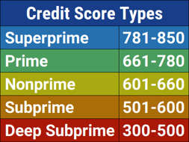
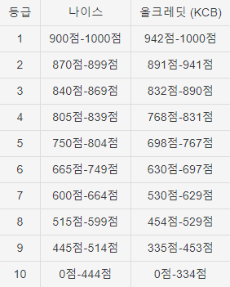
Subprime?

Slide 3
Mortgage?

Slide 4
Threshold
Low-interest loan policy was implemented by U.S. gov.
Many people borrowed money from the bank.
American housing market was getting hot.
Bank started issuing MBS – Mortgage Backed Security.

Slide 5
MBS – The first bubble
Loan
Debtor A
Bank
Investor
Repay
Debtor B
Loan
Invest
Repay
Repay
.
.
.
Mortgage
MBS

Slide 6
Deepen
Low-interest loan policy was abolished by U.S. gov.
Bank started issuing NINJA loan.
More people borrowed money from the bank.
No Income
No Job
No Assets
The investors started issuing CDO - Collateralized Debt Obligation .

Slide 7
CDO – The second bubble
Bank
Investor
Insurance
Instead
repay
Invest
Repay
Insurance fee
MBS
CDO

Slide 8
Collapse
Repaying overdue was getting hard.
People started to sell their houses (House prices had fallen).
Failed in mortgage, MBS, CDO.

Slide 9
Result
5 trillion dollars in pension money, real estate value, 401k, savings and bonds had disappeared
8 million people lost their jobs, 6million lost their homes just in USA

Slide 10
Thank you

